Slide 1

Interactive Statistics Mapping Application
CMSC 447 - Session 2
Team Name: Codepods
Team Members: Kevin Miller, David Pan, Benjamin Hazlett, Desiree Mercuree,
Darrell Laffoon, Ian Moskunas
Class Hours: Tuesday/Thursday 5:30 - 6:45
Class Location: Fine Arts 313

Slide 2
Goal of the Project
The goal of the Interactive Statistic Mapping Application is to provide a visualization of demographic information to figure out where to live
The visualization was achieved using heatmaps and kml layers in Google Maps
Heatmaps are used to visualize data concerning crime and commute time
A kml layer is used to visualize data concerning income
Data is acquired using the various backend APIs

Slide 3
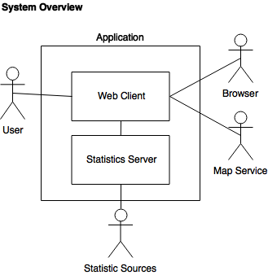
General Architecture
Frontend and backend are completely separate
Each has a unique git repository
The backend gets information from various APIs
The front end will then make a http request from the backend server
This will get the data to be displayed

Slide 4
Frontend Architecture
ReactJS - this framework allows for dynamic web pages
SemanticUI - provides the styling of the webpage
Axios - performs the http request to the back end server
Google Maps API - provides the interactive map and data layers

Slide 5
Backend Architecture
Exposed API Endpoints
Crime API
Commute API
Income API
Common interface
Input Parameters
Map Border Coordinates
Output
Statistical data
Map Locations
KML (if available)
Additional details (varies per statistic)

Slide 6
Testing Architecture
Mocha and Chai
Unit Testing
TravisCI
Integration and Regression Testing

Slide 7
Features
Dynamically updating map
Visualization will update as the user scrolls along the map
Completed - Level of Effort: 2
Information about Crime Data
Case Number, Address, City, Description, Date of Occurrence, Category, Type
Completed - Level of Effort: 3
Information about Commute Data
Commute Time, Max, MIn, Average, Long, Short, Zip Code, State, County
Completed - Level of Effort: 3

Slide 8
Features
Information about Income Data
Amount, County
???
Ability to compare these attributes by selecting different options
The map will remain in place as you select various attributes
Completed - Level of Effort 1
Data aggregation and summarization through heatmap or kml display
Green - Best, Yellow - Middle, Red -Worst
Completed - Level of Effort: 4

Slide 9
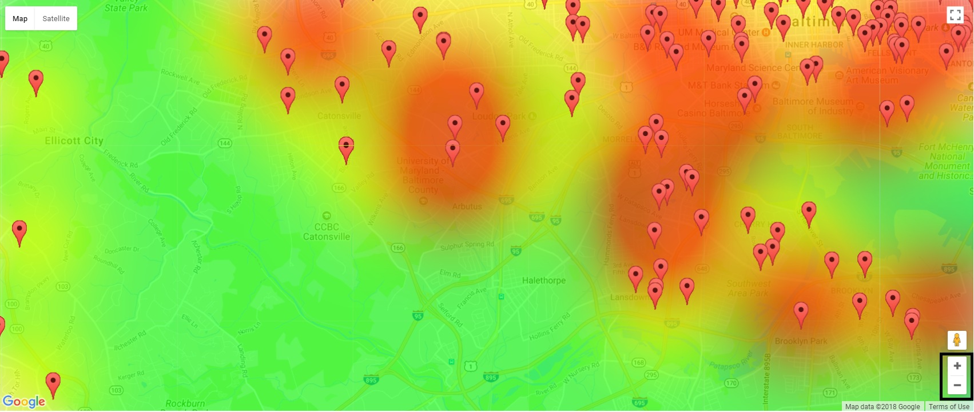
Heatmap Visualization

Slide 10
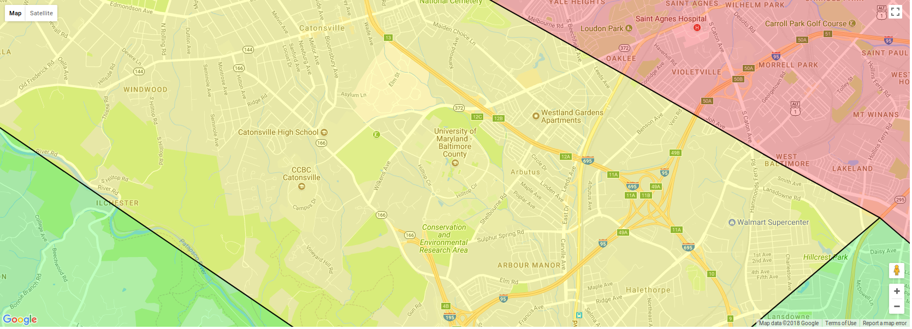
Polygon visualization

Slide 11
Documentation
All Documents are complete
Documentation still requires a sign-off by our customer

Slide 12
Code Demonstration

Slide 13
Future Versions & Recommendations
Convert Commute heatmap to use KML Polygon visualization for Zip Codes
Add ability to select Map Area using zip, state, address, etc.
Provide a clear Legend/Rubric for the current statistic
Change markers icons and colors to reflect statistic and relative value
Option to allow markers to persist from Statistic to Statistic
Add additional data sources (such as School Ranking)
Add ability to save/remember a users previous searches
Add additional search criteria based on user’s needs and ‘find’ areas that match
Address performance hit when map area is too large

Slide 14
Questions?

